Slide 1
Mood Detection and Management using Facial Expressions
The core idea of this project is to classify a person's mood using his facial expression and provide certain services according to the mood.
The services include suggesting a song as per the mood, suggesting movies, near-by get away places and management tips for the particular mood.
A web application can be designed that takes the input in the form of an image. This image can be fed to our model that detects the emotion and classifies the image either into happy face, sad face, anger face or shocked face.
Based on this class , particular services will be visible to the user.
The moods of the person can be tracked everyday and an analysis chart could be given at the end of particular month.

Slide 2
Objectives and Features
Objectives
Analyse the mood of the person with the facial expression.
Give some suggestions based on the current emotion like playing songs , suggesting get-aways
Provide a monthly analysis of the emotions to the user using charts and Graphs.
System Features
Image as an Input
Most precise conclusion
Pie Chart Analysis

Slide 3
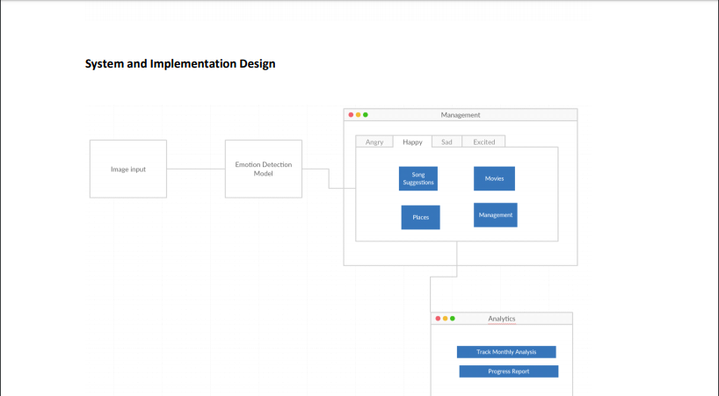
System Design

Slide 4
Technologies
• Spark
• HTML5
• Angular
• CSS
• Bootstrap
• REST API
• Scala
• Azure(Planning to Use)

